Slide 1
Journey Map
Aum Rajadnye
Associate Data Engineer

Slide 2

Journey Map
Custom Training
Aum Rajadnye
Associate Data Engineer

Slide 3
Azure Synapse Analytics (12/09/23)
Azure Synapse Analytics
Its enterprise analytics service that accelerates time to insight across data warehouses and big data systems
It brings together the best of SQL technologies used in enterprise data warehousing, Spark technologies used for big data, Data Explorer for log and time series analytics, and deep integration with other Azure services such as Power BI, CosmosDB, and AzureML
Synapse SQL - a distributed query system for T-SQL that enables data warehousing and data virtualization scenarios.

Slide 4
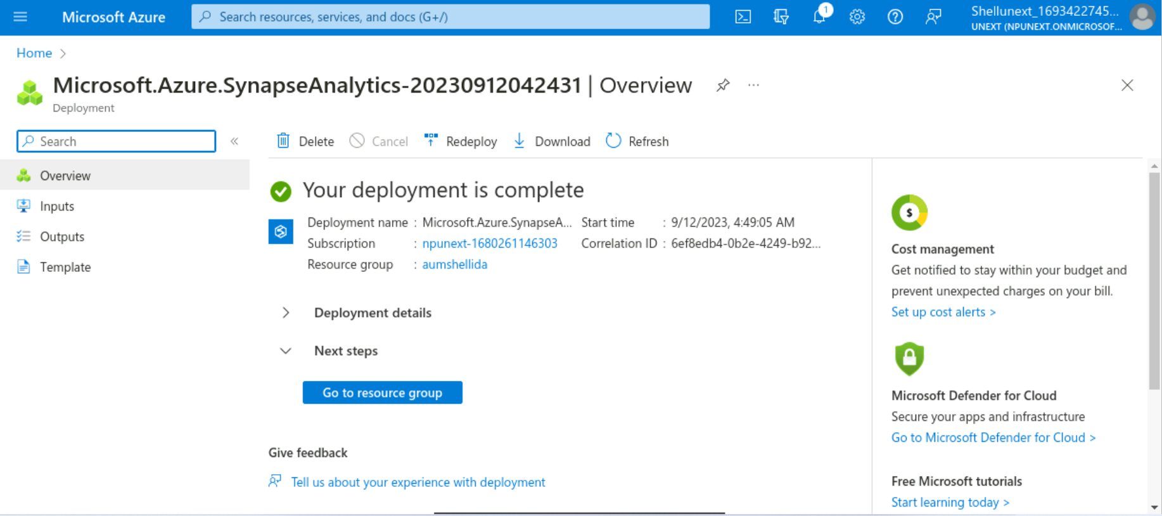

Slide 5
Power BI (13/09/23)
Power BI is a collection of software services, apps, and connectors that work together to turn sources of data into coherent and interactive insights.
Flow of work in Power BI begins by connecting to data sources in Power BI Desktop and building a report, which can then be published from Power BI Desktop to the Power BI service

Slide 6
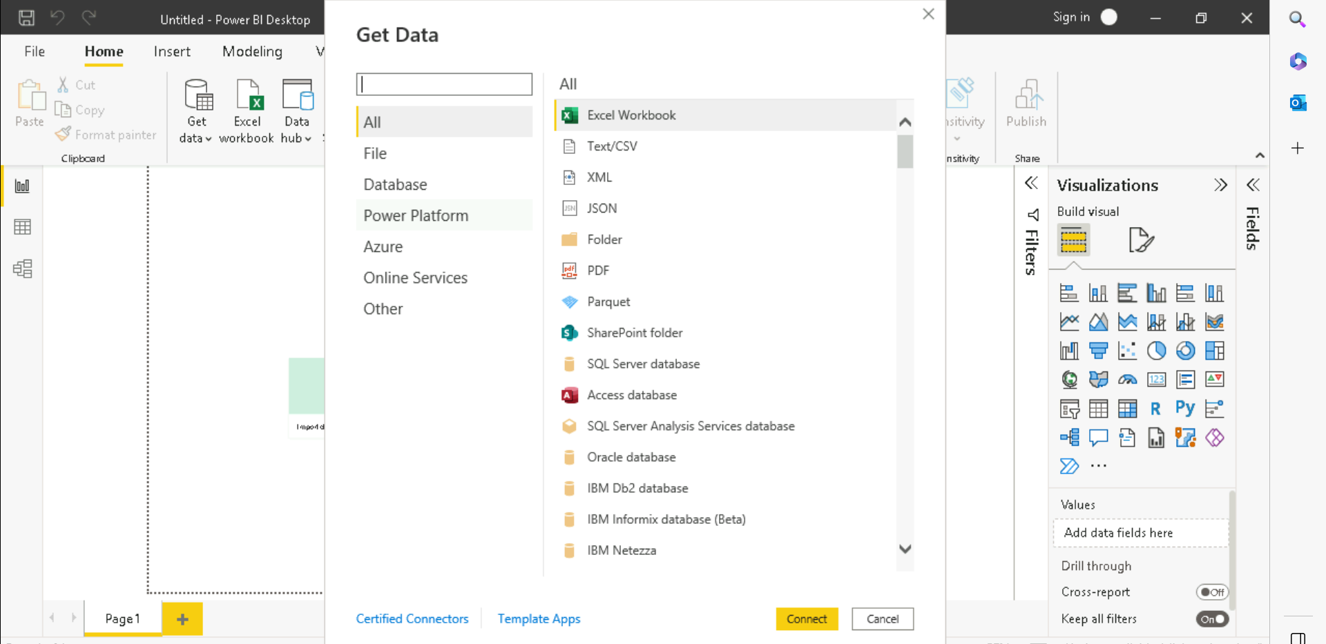

Slide 7
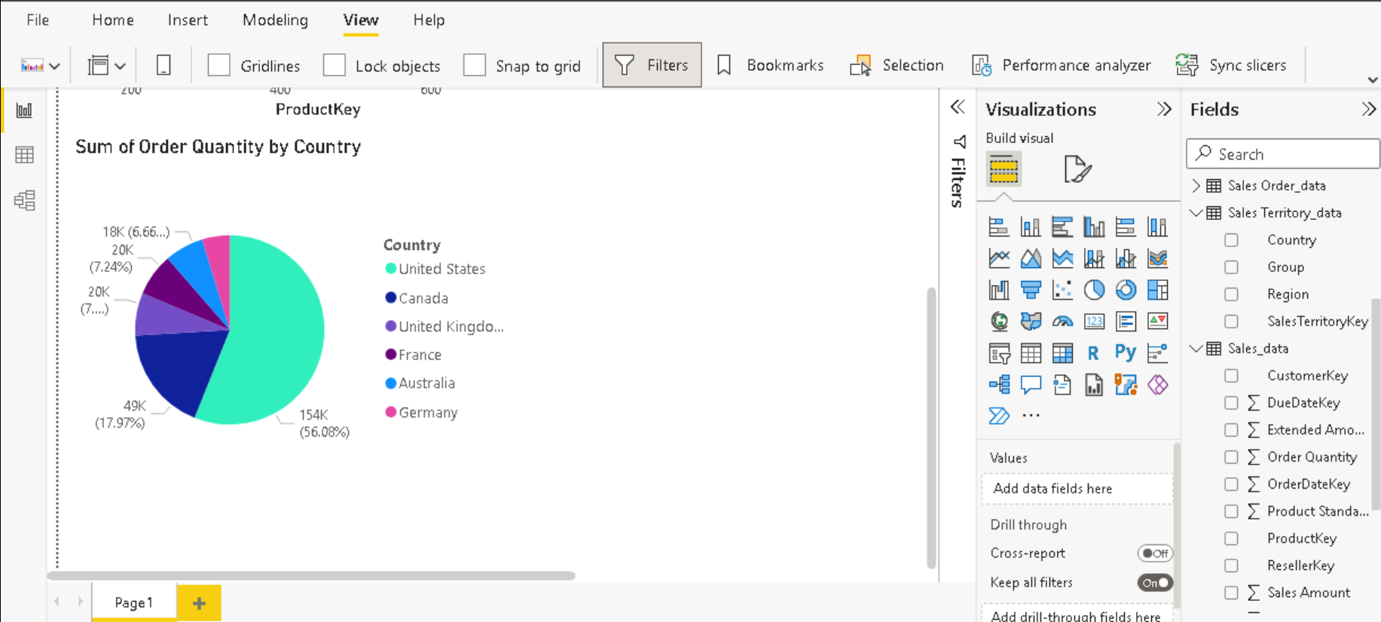
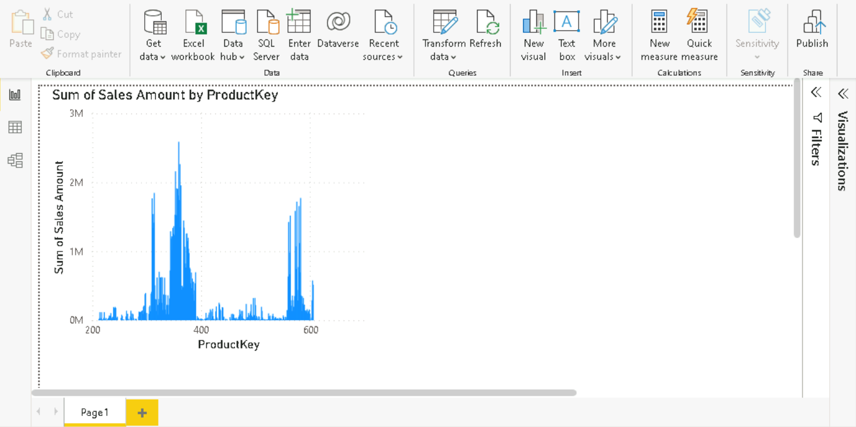

Slide 8
Power BI (14/09/23)
Loading datasets from SQL server to Power BI
Managing relationships among entities in Power BI
Data Hierarchy
Drill Up and Drill Down in Power BI
Create roles to manage visualizations of data

Slide 9
Python (15/09/23)
Features of Python
Dynamically typed
Datatypes in Python
Memory management in Python
General purpose language
Type Inference

Slide 10
